Slide 1
Welkom
13
APRIL

Slide 2


Azure Cost Management
Martijn Brant

Slide 3

Who am I?
Martijn Brant
@MartijnBrant
Cloud Architect

Slide 4
Why are we here?
Cost Management in Governance Framework
Cost Control
Cost Optimization
Also… Money € $ ₿

Slide 5
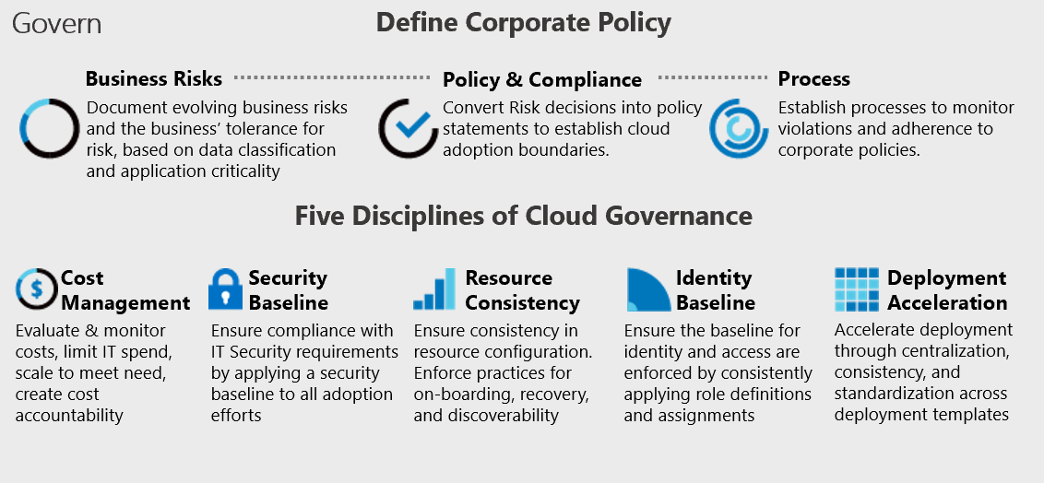
Cost Management
Part of the Cloud Governance Framework

Slide 6
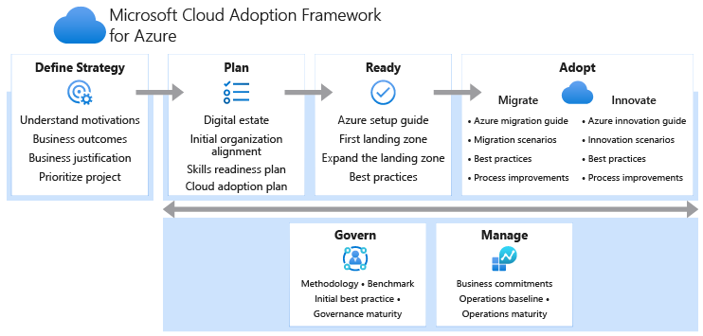
Cloud Governance
Part of the Cloud Adoption Framework

Slide 7
Cost Control
Controlling cost of your Azure resources
Cost Analysis
Budgets
Alerting
Tagging

Slide 8
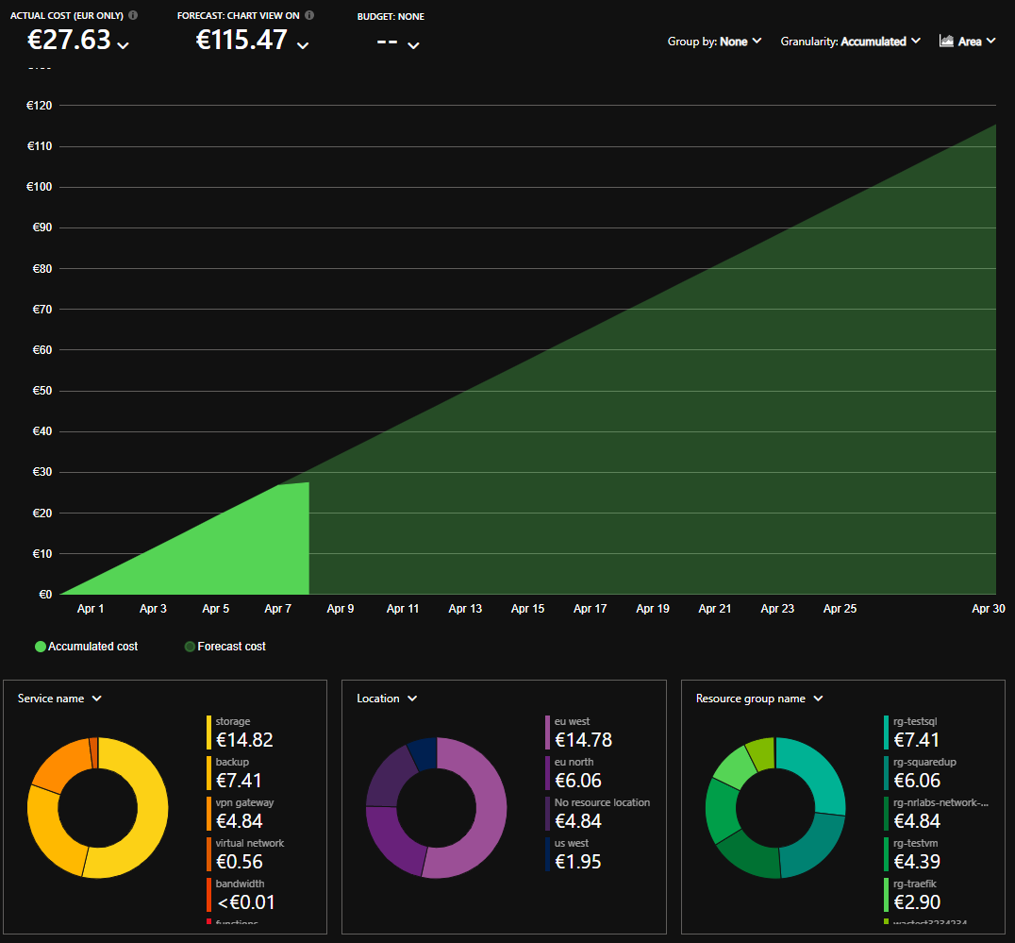
Cost Control
Cost Analysis

Slide 9
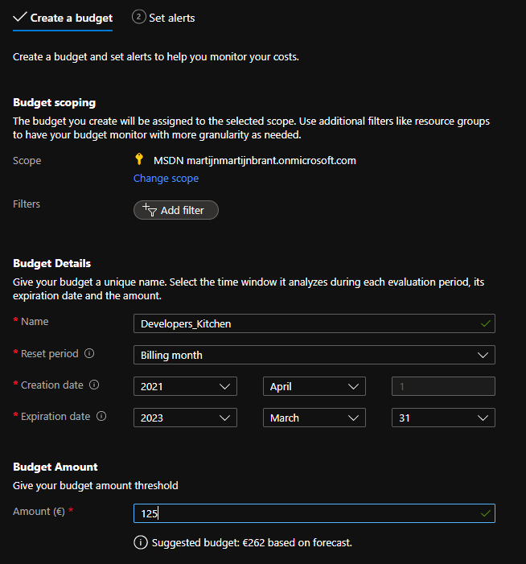
Cost Control
Budgets

Slide 10
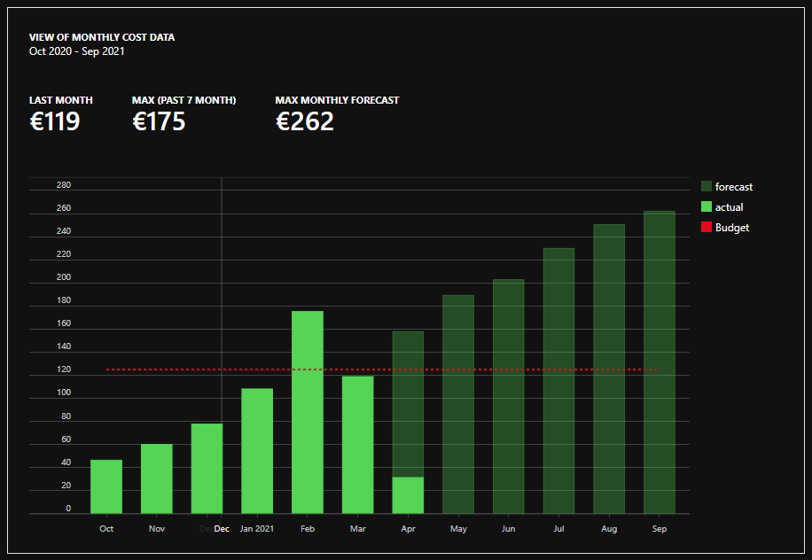
Cost Control
Budgets

Slide 11
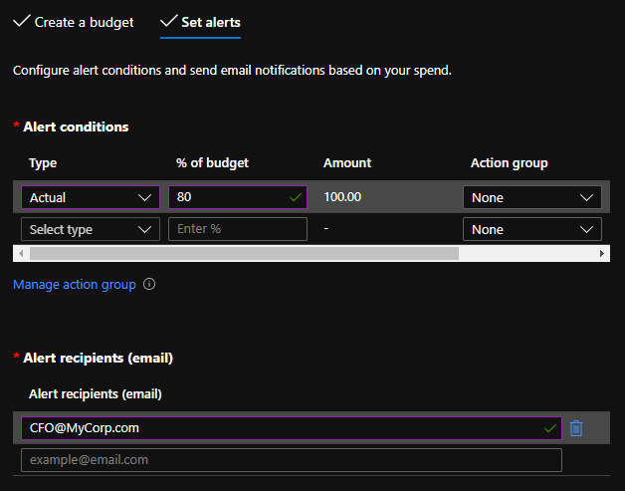
Cost Control
Alerting

Slide 12
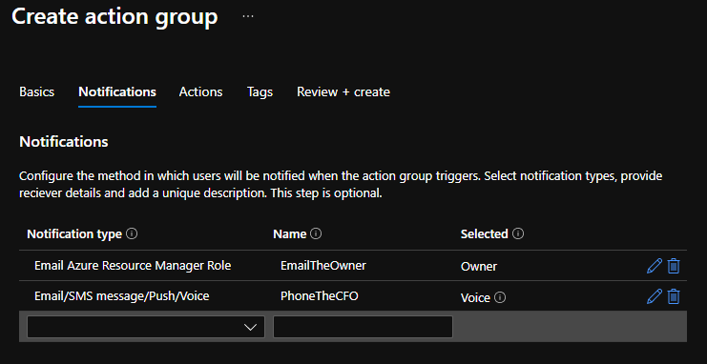
Cost Control
Alerting
Notifications

Slide 13
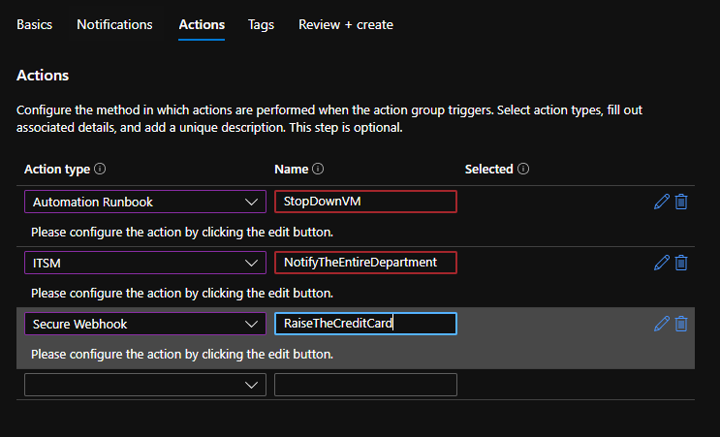
Cost Control
Alerting
Actions

Slide 14
Cost Control
Tagging
You already tag resources, right?
Grouping resources per tag
Insight per department/service
Tag needs to be set on Resource level
Bonus tip: Use Azure Policy

Slide 15
Cost Control
What’s new lately
CSP: Migrate to Azure Plan/NCE
Cost view for multiple subscriptions
Set alerts for forecasted costs
Quick Link to Resource Cost Try the Preview portal and preview Cost Management preview.portal.azure.com

Slide 16
Cost Optimization
Reducing cost of your Azure resources
Move to SaaS
Optimize to PaaS
Hybrid Use Benefit
Right sizing (Azure Advisor)
Reserved instances
Turn off resources by automation

Slide 17

Cost Optimization
Move to SaaS
File Server in VM SharePoint Online

Slide 18

Cost Optimization
Move to PaaS
File Server in VM Azure Files (Storage Account)

Slide 19
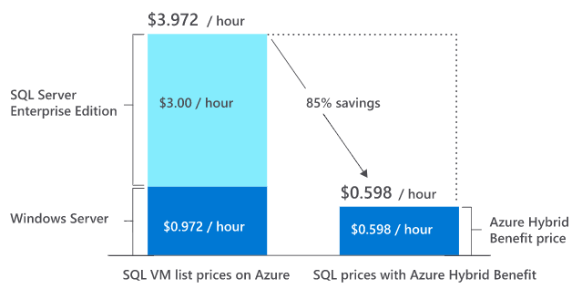
Cost Optimization
Hybrid Use Benefit
Reuse your on-prem licenses
Discount on the license component
No discount on the VM/compute component

Slide 20
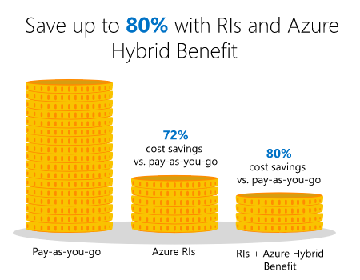
Cost Optimization
Reserved instances
Agree to long term usage (1 to 3 yr)
Discount on VM/compute pricing
No discount on license component but can be combined with HUB

Slide 21
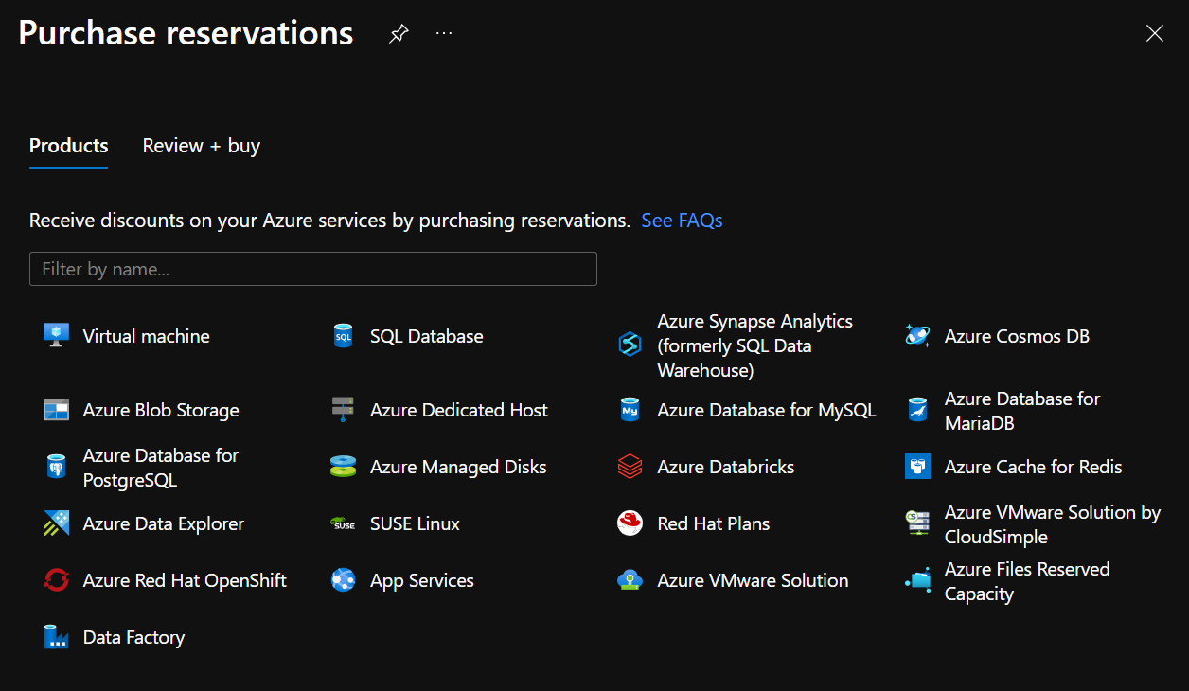
Cost Optimization

Slide 22
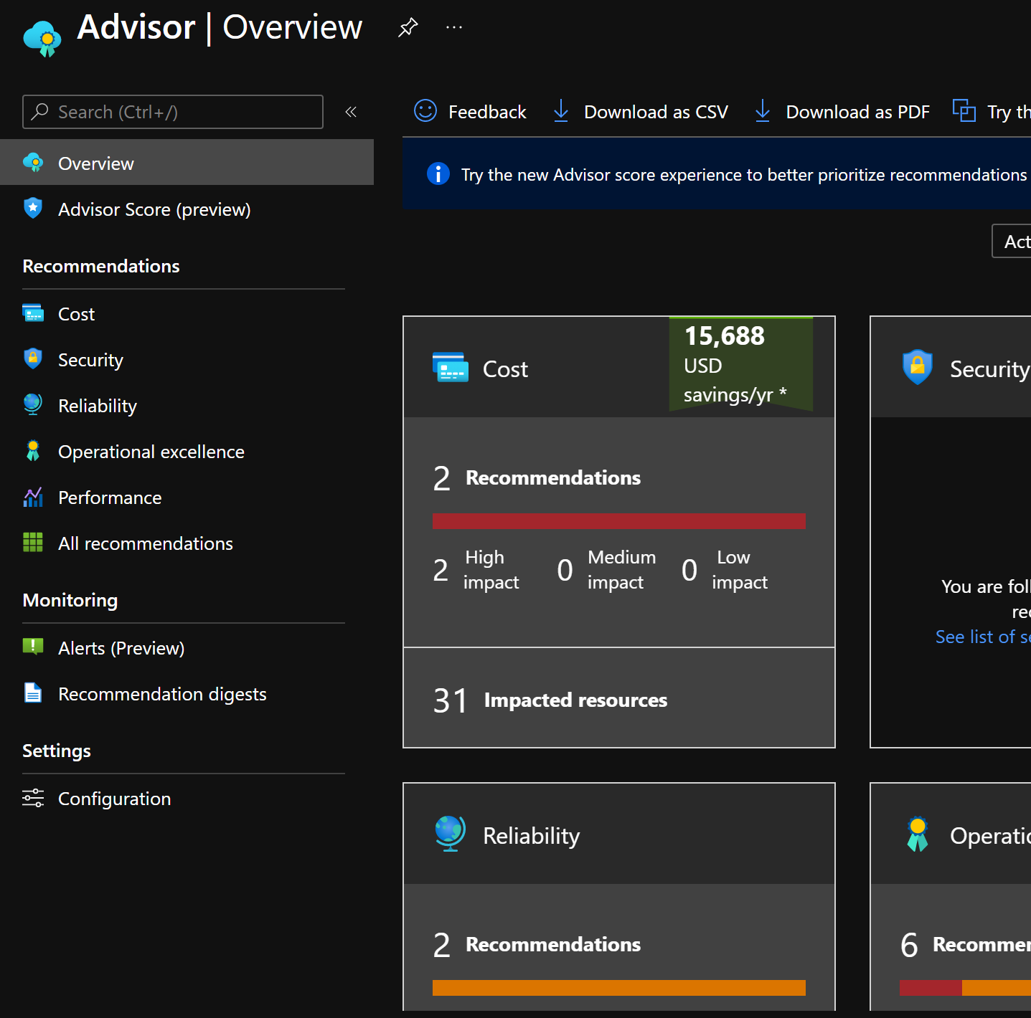
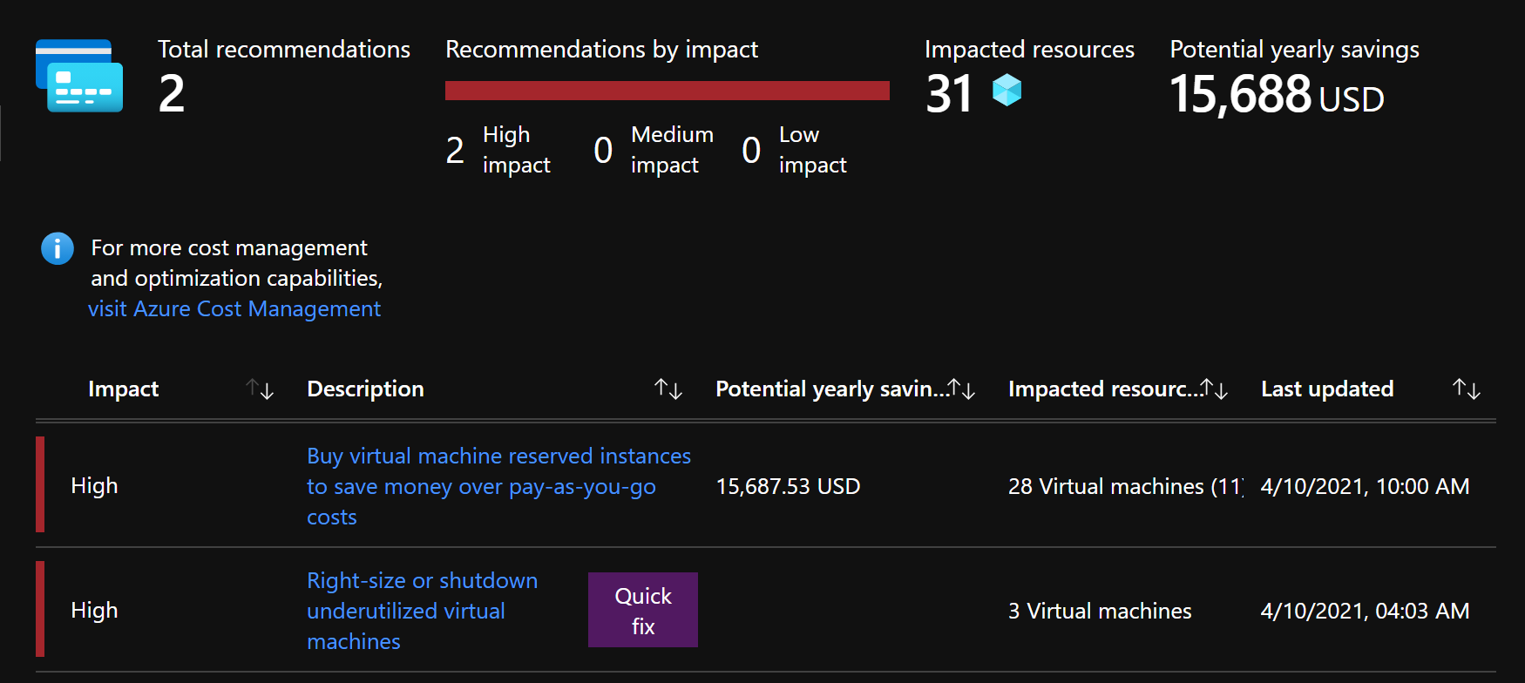
Cost Optimization
Azure Advisor / Right sizing

Slide 23
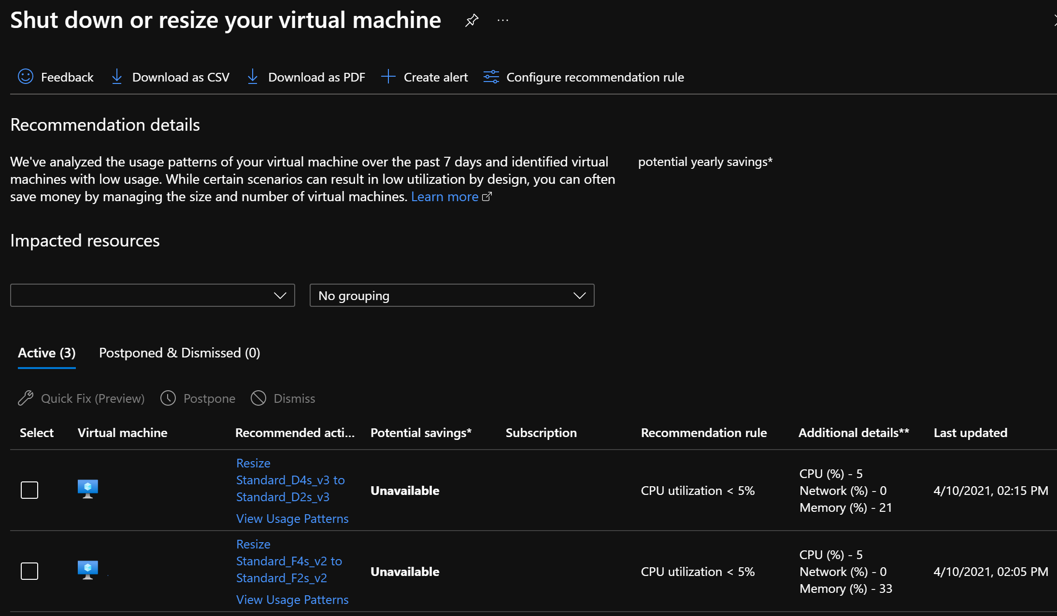
Cost Optimization

Slide 24
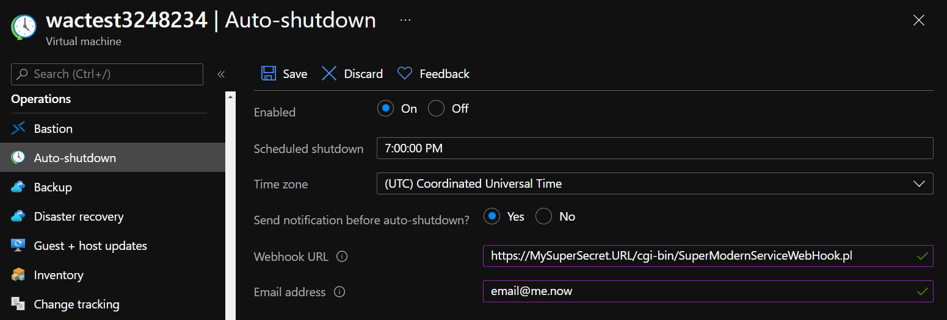
Cost Optimization
Turn off resources (by automation)
Mon-Fri 08:00 – 18:00 = Less than 30% of the week.

Slide 25
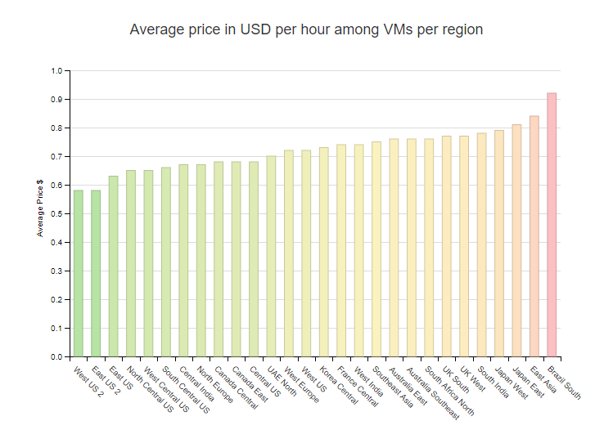
Cost Optimization
Reducing cost of your Azure resources
Type of subscription: Retail / Pay as you Go MSP / CSP Enterprise Agreement Non-profit / charitable
Azure Region (within latency/governance)

Slide 26
Cost Optimization
Reducing cost of your VMs
Service SKU (speed vs SLA)
Burstable VMs
Azure Spot (low cost VM instances)
Azure Batch (low priority VM instances)

Slide 27
Cost Optimization
Some great resources
Azure Calculator (MS: aka.ms/azurecalculator)
Azure Cost Management Blog (MS: aka.ms/costmgmt/blog)
AzurePrice.net (3rd party)
AzureCharts.com (3rd party)

Slide 28


Slide 29

Time for coffee

